Slide 1
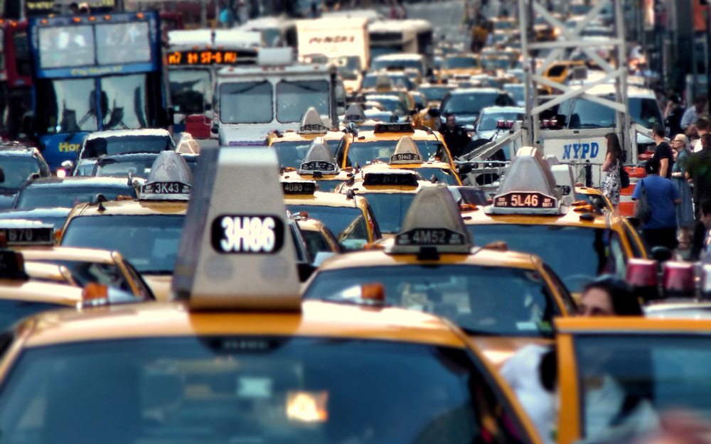
Motor Vehicle Collisions in New York City:
Exploratory Data Analysis
Introduction to Data Science
Section 10, Group 7
6 March 2017
Sadaf Asrar
Nelson Foster
Zhengzheng Yu

Slide 2
Background
Began preliminary research using OpenData.gov
a public repository of datasets collected by local, state, and federal government
New York City Police Department (NYPD) Motor Vehicle Collisions
Dataset gathered from the details and metadata from motor vehicle collisions collected in NYPD reports from July 2012 to present. The data is refreshed weekly, and made available to the public via the NYC Open Data Project.
Initial research-driven question: "What are the most dangerous areas in New York City for traffic collisions"

Slide 3
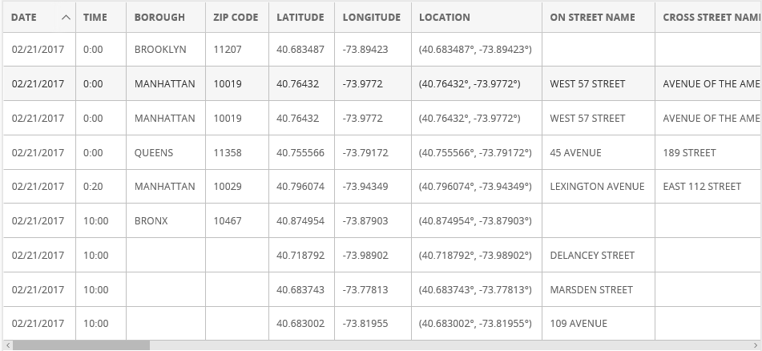
Exploratory Data Analysis (EDA) and Survey of Existing Research
Over 984,000 observations of 29 distinct variables, such as DATE, TIME, ZIP CODE, LOCATION, STREET NAME, NUMBER OF PERSONS INJURED, NUMBER OF PERSONS KILLED, VEHICLE TYPE, etc.:

Slide 4
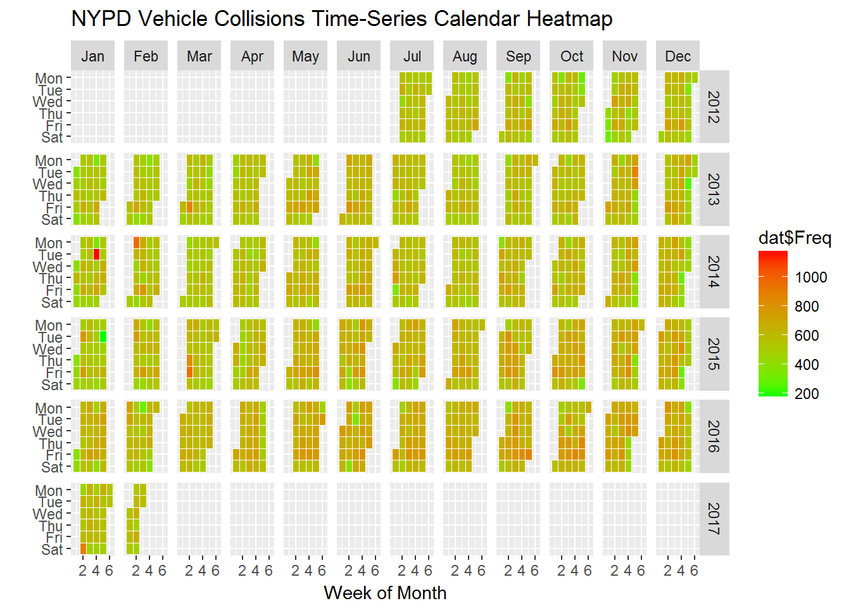

Slide 5
EDA and Survey of Existing Research (Cont’d)
Limitations to the dataset
Missing data
Lack of key dimensions for more in depth analysis
Severity of injury
Proximity to hospital
Weather and/or traffic conditions at time of collision
Substantial existing research covered various iterations of our research question
Notes:
Limitation 1: While the dataset includes variables for number of persons injured and number of persons killed, it does not contain any measure of the severity of the injury. In other words, while we can assess the number of people injured, we cannot identify the extent of the injury
Limitation 2: Additionally, variables like proximity to the nearest hospital and traffic conditions could be confounding factors to how severe the injury from the collision was or whether any of the injured party died waiting for medical attention. In other words, the relationship of injury and death from collision versus time could be further explored by controlling for proximity to the nearest hospital and traffic conditions at the time of the collision. Proximity to a hospital might affect the severity of injury or even death, as close proximity could mean that paramedics could not only get at the scene of the collision faster, but also take the injured individuals to the hospital quicker. Similarly, the state of traffic congestion at the time of collision could not only influence likelihood of accidents, but also the response time for paramedics to provide medical support, which in turn can influence the extent of injuries suffered.
Survey of existing research: As of February 19, 2017, there were over 50,000 views of the dataset, resulting in over 16,000 downloads. Several research projects have been completed and published to NYC open data using the collisions dataset. In addition, several analyses of the collisions dataset have been completed and published on other sites and blogs.
An interactive visualization was developed and published on the NYC OpenData page, summarizing several key variables in the Collisions dataset. Specifically, the visualization included:
A run chart of the number collisions by date, July 2012 through present
A bar chart of the number of collisions by borough
A map by the “Locations” variable
A map by Zip Code
Several searchable analyses where the user can search by
Zip code
“Off Street”
“On Street”
Several Bar charts summarizing several variables:
Number of persons injured
Number of persons killed
Number of cyclists injured
Number of cyclists killed
A heat map was developed and published to the NYC OpenData page, created using the details of the collisions dataset, allowing the user to look at concentration of collisions by location.
An interactive filter analysis was developed and published to the NYC OpenData page, created using the details of the dataset, allowing the user to filter, pivot, and use conditional formatting to drill down to specific subsets and intersections of the data.
NYPD Motor Vehicle Collisions Research Part#1
Asenscio (2008) utilized the Collisions dataset to develop several analyses in a report entitled including
Collisions by seasons
Collisions by borough
Accidents per day of week
Highest contributing factors
Contributing factors per borough, by season, by number of persons killed
Collisions by vehicle type
“Most Dangerous Boroughs”
Most dangerous intersections for pedestrians
Reasons why most collisions occur
New York City Vehicle Collision Analysis
Tyokogawa (2015) analyzed the collisions dataset by utilizing a clustering algorithm to evaluate the correlations between intersections and weather conditions, identifying the most dangerous locations susceptible to foul weather such as heavy rain or snow.
NYPD Motor Vehicle Collisions Data
Google Cloud Platform had a post that analyzed the NYPD Collisions dataset by evaluating the most common factor for motor vehicle collisions, and the most dangerous streets for motor vehicle collisions.
Visualizing Traffic Accidents on Staten Island
Using the NYPD Collision dataset, Pratt Institute School of Information developed several dashboards evaluating the following factors relating to collisions on Staten Island:
Top ten causes of accidents
Accident frequency by time of day
Accident frequency by time of day per (Staten Island) neighborhood
Traffic accidents per neighborhood
NYC Fatal Motor Vehicle Collisions hotspots
Bilogur (2016) utilized the NYPD Collisions dataset to develop a Tableau Visualization highlighting the “inherently dangerous” intersections for motor vehicle collisions within New York City.

Slide 6
Refining the Research Question Based on EDA
As a result of so much existing research covering our initial question, our research question was refined to an area not covered in-depth NYC wide:
“What is the most dangerous time for motor vehicle collisions in NYC?”

Slide 7
Is it a S.M.A.R.T. Question?
Is it Specific?
Is it Measurable?
Is it Achievable?
Is it Relevant?
Is it Time-Bound?
Notes:
Establishing a S.M.A.R.T. Question
Is it Specific?
Our research question is specific in that it looks at the time variable to identify the most dangerous times of day for motor vehicle collisions in New York City, in particular those resulting in injury of death for motorists/vehicle occupants, pedestrians, and cyclists in
Is it Measurable?
Due to the high level of granularity in the metadata aggregated by the NYPD Motor Vehicle Collisions dataset, we are afforded 29 unique variables to evaluate nearly a million observations over the course of five years. This allows the time dimension to be applied to several other variables for measurable results.
Is it Achievable?
The dataset is a relatively small tabular formatted dataset, making analyzing the dataset is quite achievable so with conventional resources (RStudio, laptop computer). Utilizing several packages in R to convert various data elements into quantifiable measures makes this achievable.
Is it Relevant?
Our research question expands on existing research by conducting more extensive analysis on the time variable and how it correlates to other variables relating to injury or death due to being involved in a motor vehicle collision.
Is it Time-Oriented?
Our research question is time oriented in that it is an aggregation of motor vehicle collisions from July 2012 to February 2017. Though the dataset is updated weekly on New York City’s OpenData website, we took a snapshot of the data of February 2017 in order to have a finite dataset. Further, our analysis specifically focuses on the time variable, i.e., the time of day a collision occurred.
To sketch an answer to our refined research question of “What is the most dangerous time for motor vehicle collisions in NYC?”, we took the steps described below.

Slide 8
Defining “Dangerous”
While the dataset includes variables for number of persons injured as well as number of persons killed in the collision, there is no composite variable for all injuries or death.
Additionally, the dataset does not include an index for severity of injury, as injury could range from minor cuts and bruises to brain and spinal cord damage.
To define “dangerous”, we simply combined the two variables that captured the number of persons injured and number of persons killed in the collision to create a composite variable for number of persons injured and killed in the collision.
We attempted to answer our research questions using this variable as a metric for “dangerous” collision.

Slide 9
Defining “Dangerous” (Cont’d)
Exploring the number of people injured and killed for the 24 hours of the day

Slide 10
Hours | Number of collisions in each hour | Number of people injured and killed in each hour | Mean number of people injured and killed in each hour
0:00 | 24,193 | 7,207 | 0.2978961
1:00 | 15,467 | 4,991 | 0.322687
2:00 | 11,912 | 4,137 | 0.3472968
3:00 | 10,087 | 3,568 | 0.3537226
4:00 | 11,806 | 4,505 | 0.3815856
5:00 | 12,750 | 4,270 | 0.334902
6:00 | 19,887 | 5,838 | 0.2935586
7:00 | 26,632 | 7,735 | 0.2904401
8:00 | 55,360 | 12,988 | 0.2346098
9:00 | 55,033 | 11,074 | 0.2012247
10:00 | 50,599 | 9,958 | 0.1968023
11:00 | 52,253 | 10,851 | 0.2076627
12:00 | 55,290 | 11,814 | 0.2136734
13:00 | 58,351 | 12,866 | 0.2204932
14:00 | 67,056 | 15,294 | 0.228078
15:00 | 60,454 | 15,266 | 0.2525226
16:00 | 73,434 | 17,344 | 0.2361849
17:00 | 71,026 | 17,743 | 0.2498099
18:00 | 62,804 | 17,000 | 0.2706834
19:00 | 51,143 | 14,311 | 0.2798232
20:00 | 42,624 | 12,965 | 0.3041714
21:00 | 34,886 | 10,806 | 0.3097518
22:00 | 31,366 | 10,104 | 0.3221322
23:00 | 25,452 | 8,660 | 0.3402483

Slide 11
Correlation between number of people injured and killed against time
The correlation coefficient tells us the relationship between number of people killed and injured versus time in 24 hours, i.e., do the number of injures and death in motor vehicle collisions increase when the time (measured in 24-hour scale) increase.
The correlation coefficient is 0.0212, which is very weak. While the correlation found is weak, it actually may not be the best way to test this relationship.

Slide 12
Defining “Time of Day”
To test this relationship differently, we decided to split up the day in six different times of day, i.e., late night (0:00-03:59), early morning (04:00-07:59), morning (08:00-11:59), afternoon (12:00-15:59), evening (16:00-19:59), and night (20:00-23:59).
For the rest of the analysis we use this time of day variable as a measure of time.

Slide 13
Are the number of people injured and killed different for different time of day?
To answer this question, we first conducted a one-way ANOVA, which tests whether the number of people injured and killed are statistically significantly different for the six different times of day.
The one-way anova result produces a p-value of 2.2e-16, which is below the critical value of 0.05, which means, yes, the number of people injured and killed are different for the six different times of day.
However, we do not know which time of day has most injuries and death or which time of day has the highest mean injuries or death.

Slide 14
Which time of day were the largest of people injured and killed?
Time of day | Number of people injured or killed
Afternoon | 55,240
Early morning | 22,348
Evening | 66,398
Late night | 19,903
Morning | 44,871
Night | 42,535

Slide 15
Which time had largest mean number of people injured and killed?
Time of day | Mean number of people injured or killed
Afternoon | 0.2290681
Early morning | 0.3144284
Evening | 0.2569512
Late night | 0.3227915
Morning | 0.2104199
Night | 0.3166503

Slide 16
Are the number of people injured and killed at late night different from all other times of day?
To answer this question, we conducted a t-test of the number of injuries and death over the binary variable of whether the collision was at late night versus non-late night.
t.test(no_inj_kill ~ late_night, collision)
Welch Two Sample t-test
data: no_inj_kill by late_night
t = -22.575, df = 67845, p-value < 2.2e-16
alternative hypothesis: true difference in means is not equal to 0
95 percent confidence interval:
-0.07693276 -0.06464130
sample estimates:
mean in group 0 mean in group 1
0.2520045 0.3227915
The t-test result of number of people injured and killed during light night vs non-late night is statistically significant at the 5% level, which indicates that the number of people injured or killed in traffic collisions at late night are different from collisions at all other times of the day.

Slide 17
Are the number of people injured and killed at late night different from EACH of the other times of day?
To answer this question, we conducted t-tests of the number of people injured or killed in collisions at late night with each of the other times of the day.
Late Night vs. Night
Late Night vs. Early Morning
Late Night vs. Morning
Late Night vs. Afternoon
Late Night vs. Evening
The t-test results show that the mean number of people injured and killed at late night is statistically significantly different from each of the other times of day.
This means that the mean number of people injured and killed at late night is different from each of the other times of day.

Slide 18
So, what is the most dangerous time of day?
Based on the exploratory data analysis we performed, if we are using the raw number or count, it is evening, as evening has the highest number of people who were injured and killed in motor vehicle collisions.
However, if we factor in that the number of collisions differs for different times of day, then the most dangerous time for traffic collisions is late night, as it has highest mean number of injuries and death per motor vehicle collision.
The number of injuries and death per motor vehicle collision at late night was statistically significantly different for each of the other times of day.

Slide 19
So, what is the most dangerous time of day? (Cont’d)
Time of day | Number of collisions for each time of day | Number of people injured or killed | Mean number of people injured or killed
Afternoon | 241,151 | 55,240 | 0.2290681
Early morning | 71,075 | 22,348 | 0.3144284
Evening | 258,407 | 66,398 | 0.2569512
Late night | 61,659 | 19,903 | 0.3227915
Morning | 213,245 | 44,871 | 0.2104199
Night | 134,328 | 42,535 | 0.3166503

Slide 20
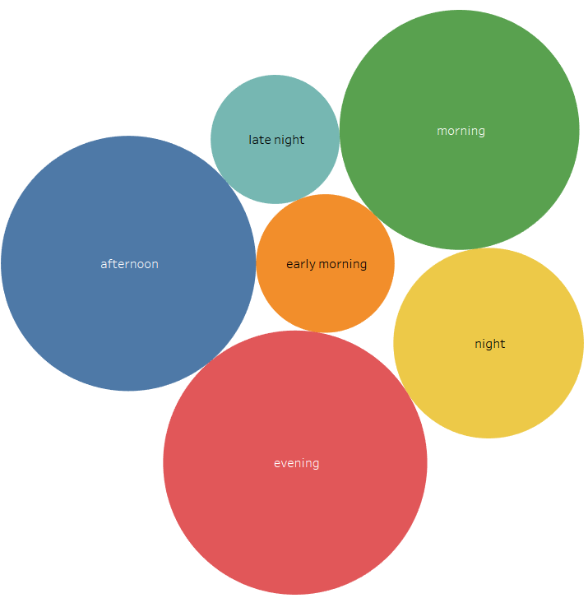
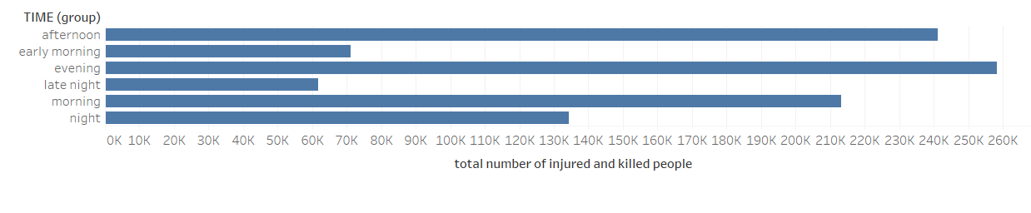
To people live in the NY:
Be careful At the evening!!!

Slide 21
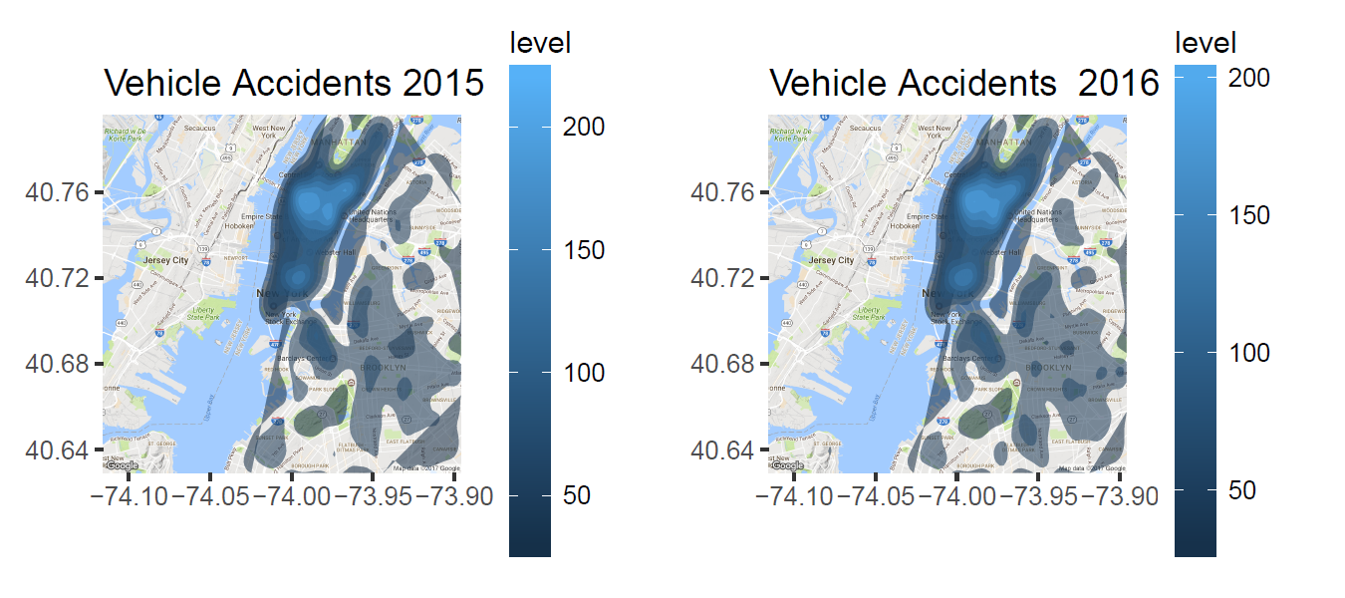
Motor Vehicle Collision Density in NYC

Slide 22
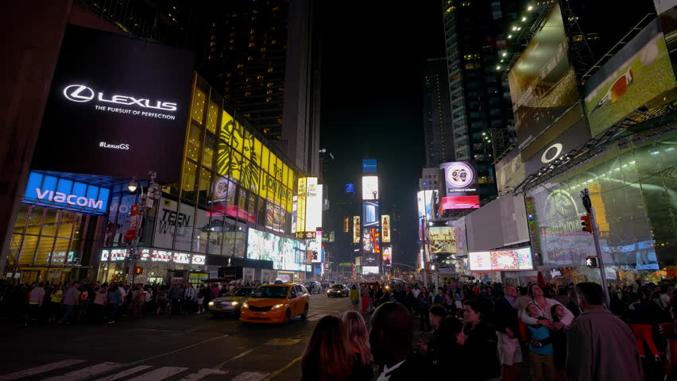
Questions?
Notes:
Image credit: http://il3.picdn.net/shutterstock/videos/10481654/thumb/10.jpg

